Slide 1
PyDSL Update Summary: 2025 June-August
Bálint Rózsa

Slide 2
Background: What is PyDSL?
Python based language that compiles to MLIR.
@compile decorator parses the AST of a function, converts it to MLIR, automatically lowers to shared library binary file.
PyDSL functions can be called directly from Python, arguments are converted to ctype, passed to shared library file.
import numpy as np
from pydsl.frontend import compile
from pydsl.memref import MemRef
from pydsl.scf import range
from pydsl.type import SInt16, SInt32
@compile()
def f(arr: MemRef[SInt32, 8, 4], x: SInt32, y: SInt16) -> SInt32:
z = x + y
for i in range(8):
for j in range(4):
arr[i, j] += z
return z
arr = np.zeros((8, 4), dtype=np.int32)
sm = f(arr, 7, 9)
print(arr)
print(sm)

Slide 3
Overview
Major features/improvements:
Open source
Tensor/memref slicing, strided memrefs
Triton interop
More linalg ops: fill, reduce, broadcast, matmul, batch_matmul
More tensor/memref ops: empty, zeros, alloc, copy, cast
Support for A3 and A5 backends
Inline functions
Better call macros
ndarray arguments are no longer deallocated too early

Slide 4
Smaller features and bug fixes
Improved existing linalg elementwise ops (e.g. binary ops now allow explicitly specifying output)
Chain assignment (a = b = c)
Augmented assignment (a += b)
Class slicing syntax outside compiled functions (MemRef[F32, 4, 8] instead of MemRefFactory((4, 8), F32)
Zero dimensional tensor/memref
Casting of arguments and return types when calling other PyDSL functions
Contributing guidelines/documentation for developers
Fix incorrect input range of integers (UInt8(255) used to error)
Only evaluate one branch of constant expression condition if statement
Full list at https://github.com/Huawei-CPLLab/PyDSL/pulls?page=1&q=is%3Apr+is%3Aclosed

Slide 5
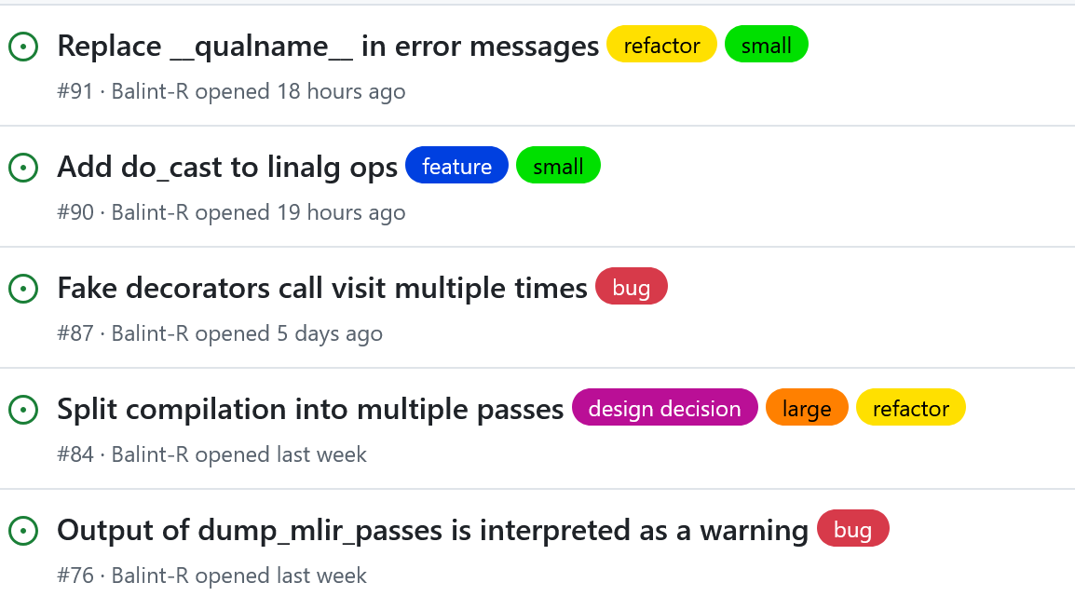


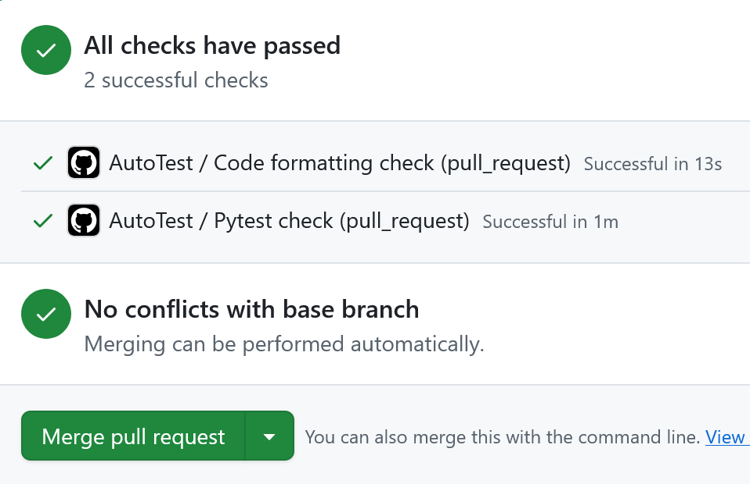
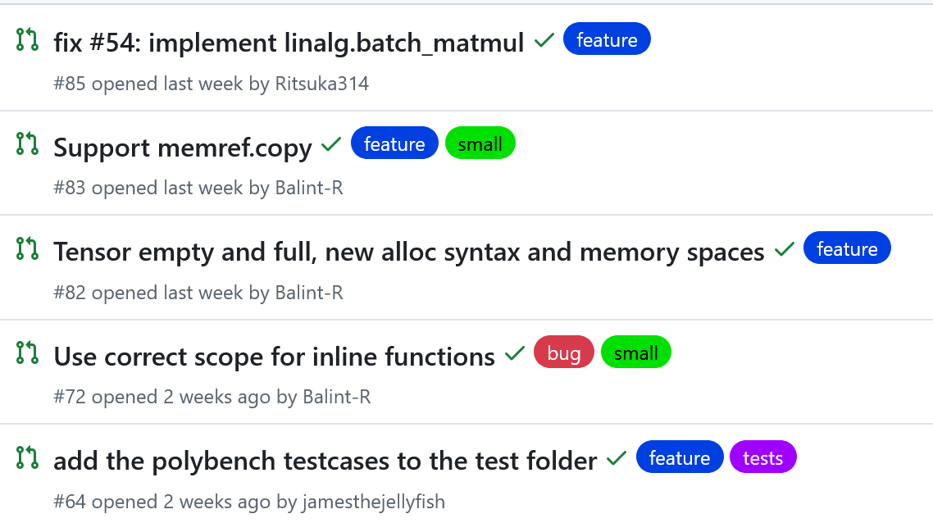
Open source development
Everything (other than AscendTarget) is open-sourced on GitHub, no longer maintain two overlapping versions
Setup CI on GitHub
Issues, pull requests, code review
Issues
CI
Code review comments
Pull requests

Slide 6
Tensor/memref slicing
Uses Python’s slicing syntax to implement memref.subview, tensor.extract_slice, tensor.insert_slice
MemRefs with a strided layout also have first-class support now
def test_load_compose_strided():
@compile()
def f(t1: Tensor[F32, 16, 12]) -> TensorF32_2:
t2 = t1[1:15:2, ::3]
return t2[1::3, 1::2]
n1 = multi_arange((16, 12), np.float32)
n1_sub = n1[1:15:2, ::3][1::3, 1::2]
assert (f(n1.copy()) == n1_sub).all()
def test_load_strided():
MemRefStrided = MemRefFactory((10, 5), F32, offset=123, strides=(1, 10))
@compile()
def f(m1: MemRefStrided) -> MemRefStrided:
return linalg.exp(m1)
f32_sz = np.float32().nbytes
n1 = multi_arange((10, 5), np.float32)
n1 = as_strided(n1, strides=(f32_sz, 10 * f32_sz))
cor_res = np.exp(n1)
assert np.allclose(f(n1), cor_res)

Slide 7
Triton interoperability
Call Triton functions from within PyDSL
Triton function is converted to MLIR and added to the MLIR module of the PyDSL function
@triton.jit
def kernel(x_ptr, y_ptr, output_ptr, n_elements, BLOCK_SIZE: tl.constexpr):
...
ArrayType = MemRefFactory((DYNAMIC,), F32)
@compile()
def func_test(x: ArrayType, y: ArrayType, out: ArrayType):
size: Index = 98432
BLOCK_SIZE = 64
index_size = size // BLOCK_SIZE
for i in range(0, index_size):
kernel(x, y, out, size, BLOCK_SIZE, i)

Slide 8
C++-style templates
Specify template parameters in square brackets
The function is compiled every time it is called with new unique template args
@template()
def manual_transpose[T, N, M](arr: MemRef[T, N, M]) -> MemRef[T, M, N]:
brr = alloc((M, N), T)
for i in range(N):
for j in range(M):
brr[j, i] = arr[i, j]
return brr
N = 512
M = 64
arr = multi_arange((N, M), np.int32)
brr = manual_transpose[SInt32, N, M](arr)
Notes:
Code snippet doesn’t quite work right now, due to improper support of Constexpr.

Slide 9
A3 and A5 support (performance mode)
Currently working to support Ascend A3 and A5 backends
Developed in internal BiSheng repo until AVE and HIVM dialects are open-sourced
Have a setup for outputting MLIR and automatically running on V300 boards
A big bottleneck is what MLIR bishengir-compile accepts
Implemented numerous AVE and HIVM ops

Slide 10
More linalg ops: fill, reduce, broadcast, matmul, batch_matmul
Powerful reduce op
Reduce along multiple dimensions
Specify custom combiner function using inline functions
Specify init value for combiner function
Allowed us to implement softmax demo
@compile()
def softmax_tensor(arr: Tensor[F64, N, M]) -> Tensor[F64, N, M]:
reduce_res = tensor.full((N_num,), neg_inf, F64)
reduce_res = linalg.reduce(arith.max, arr, init=reduce_res, dims=[1])
mx = linalg.broadcast(reduce_res, out=arr, dims=[1])
arr = linalg.sub(arr, mx, out=arr)
arr = linalg.exp(arr)
reduce_res = linalg.fill(reduce_res, 0)
reduce_res = linalg.reduce(_add, arr, init=reduce_res, dims=[1])
sm = linalg.broadcast(reduce_res, out=arr, dims=[1])
arr = linalg.div(arr, sm, out=arr)
return arr
@InlineFunction.generate()
def sum(a: UInt64, b: UInt32) -> UInt64:
return a + b
@compile()
def f(
arr: MemRef[UInt32, DYNAMIC, DYNAMIC, DYNAMIC],
out: MemRef[UInt64, DYNAMIC],
):
linalg.reduce(sum, arr, init=out, dims=[0, 2])

Slide 11
More tensor and memref ops
tesor.empty, tensor.full, tensor.zeros, tensor.ones, tensor.cast, memref.cast
Support for memory spaces and aligned allocation
@compile()
def f(xsz: Index) -> Tensor[UInt64, DYNAMIC, 5]:
t1 = tensor.full((xsz, 5), 123, dtype=UInt64)
return t1
@compile()
def f() -> MemRef[F64, 4, 6]:
return alloc((4, 6), F64, alignment=32)
@compile()
def f() -> Tensor[F32, 10, 10]:
return tensor.zeros((10, 10), F32)
@compile(target_class=AscendTarget)
def f():
m1 = alloc((4, 2), F32, memory_space=HIVM_AddrSpace.UB)
dealloc(m1)

Slide 12
Reference tracking ndarray arguments
Previously, if you wanted to pass an array to a PyDSL function and return it, you had to keep a reference to the original array, or else the memory would get deallocated.
Fixed by tracking arguments and return values, and adding a pointer from a new ndarray to an old one if their memories overlap to prevent deallocation.
@compile()
def f(m1: MemRef[F32, 10]) -> MemRef[F32, 10]:
return m1
arr = np.arange(10, dtype=np.float32)
new_arr = f(arr.copy())
print(new_arr)
Old: new_arr points to deallocated memory, because arr.copy() was deallocated.
New: works fine, arr.copy() is deallocated only when new_arr goes out of scope.

Slide 13
Inline functions
Functions that generate MLIR directly where they are called
Useful for linalg.reduce
Allows some compiler functions to be written in PyDSL instead of being a CallMacro
@InlineFunction.generate()
def add(a, b) -> Any:
return a + b
@compile()
def f(t1: Tensor[F32, DYNAMIC, 20]) -> Tensor[F32, DYNAMIC, 20]:
init = tensor.zeros((20,), F32)
return linalg.reduce(add, t1, init=init, dims=[1])
@CallMacro.generate()
def empty(
visitor: ToMLIRBase, shape: Compiled, dtype: Evaluated
) -> SubtreeOut:
@InlineFunction.generate()
def full(shape, val, dtype) -> typing.Any:
res = empty(shape, dtype)
return linalg.fill(res, val)
@InlineFunction.generate()
def zeros(shape, dtype) -> typing.Any:
return full(shape, 0, dtype)

Slide 14
Better call macros
Background: call macros are functions which can execute Python (not PyDSL) code directly and can be called from PyDSL
Mostly used by the compiler
Call macros can now call other call macros
Better support for different types of call macros inside classes
@CallMacro.generate(method_type=MethodType.INSTANCE)
def cast(
visitor: ToMLIRBase, self: typing.Self, shape: Evaluated
) -> typing.Self:
...
@compile()
def f(
t1: Tensor[F32, DYNAMIC, 32, 5]
) -> Tensor[F32, 64, 32, DYNAMIC]:
t2 = t1.cast((64, 32, DYNAMIC))
return t2

